Slide 1
Beneficiary Header changes

Slide 2
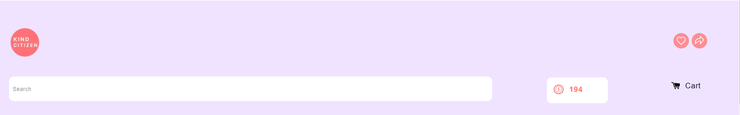
class="coloured-bg" - entire header
class="top-bar grid" - header grid
class="header-icons" - The 3 logo (kind citizen, wishlist and share)
class="grid__item small--one-third" - left grid
class="site-header grid medium-up--grid--table"
id="HeaderLogoWrapper"

Slide 3
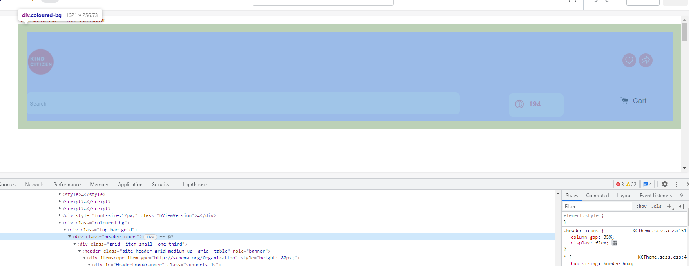
class="coloured-bg" - entire header

Slide 4
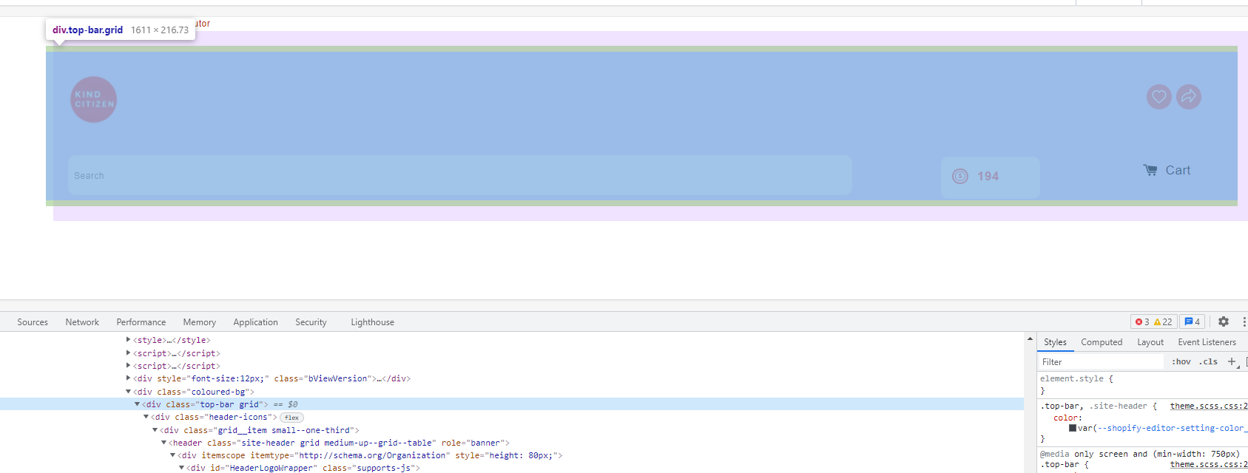
class="top-bar grid" - header grid

Slide 5
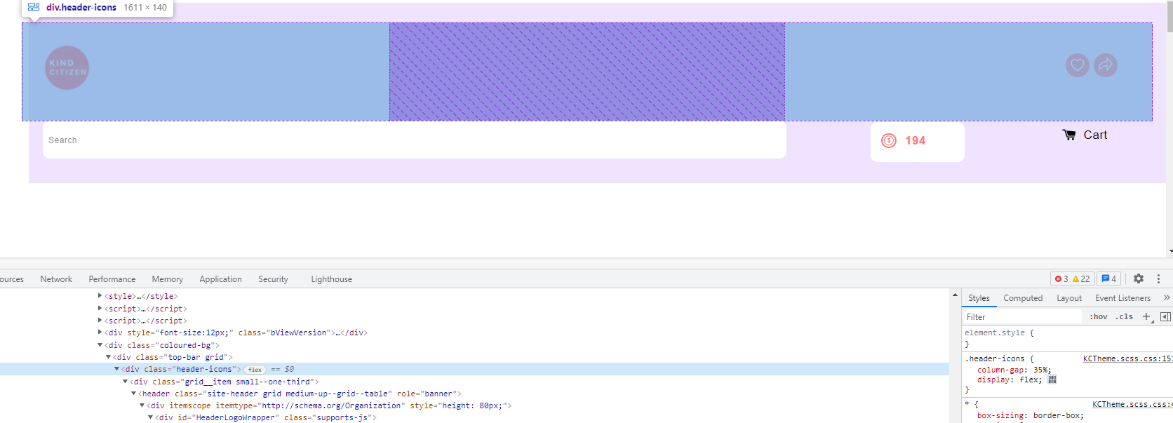
class="header-icons" - The 3 logo (kind citizen, wishlist and share)

Slide 6
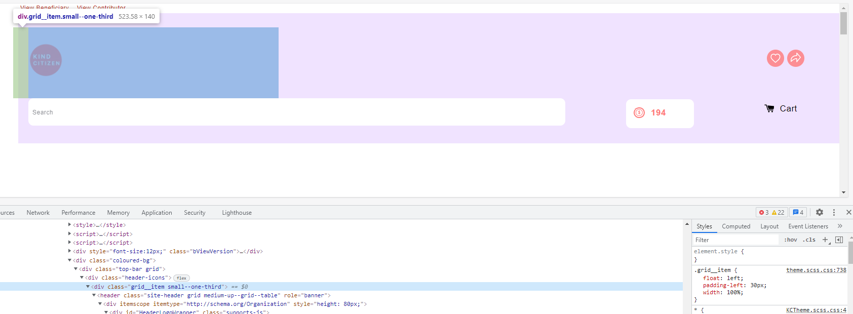
class="grid__item small--one-third" - left grid

Slide 7
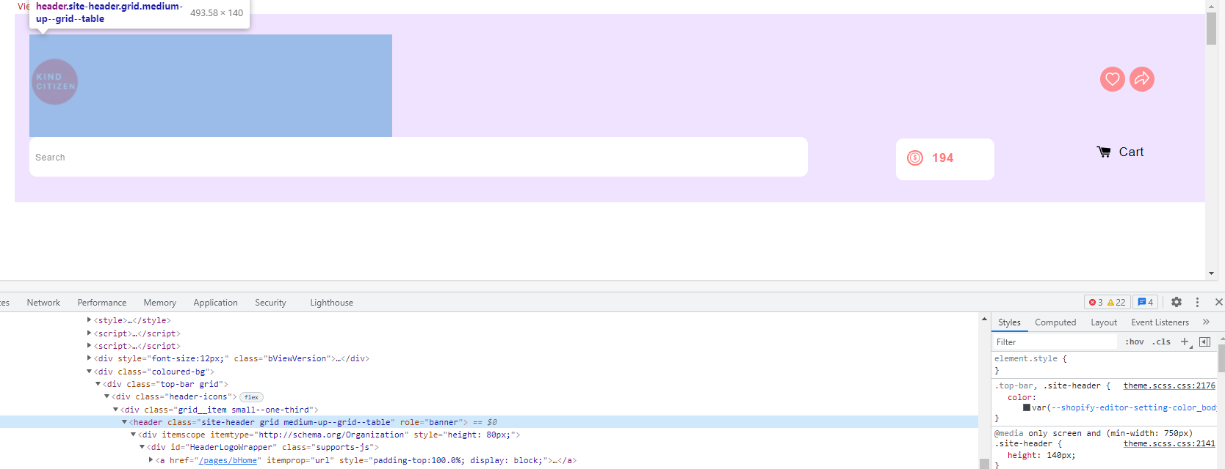
class="site-header grid medium-up--grid--table"

Slide 8
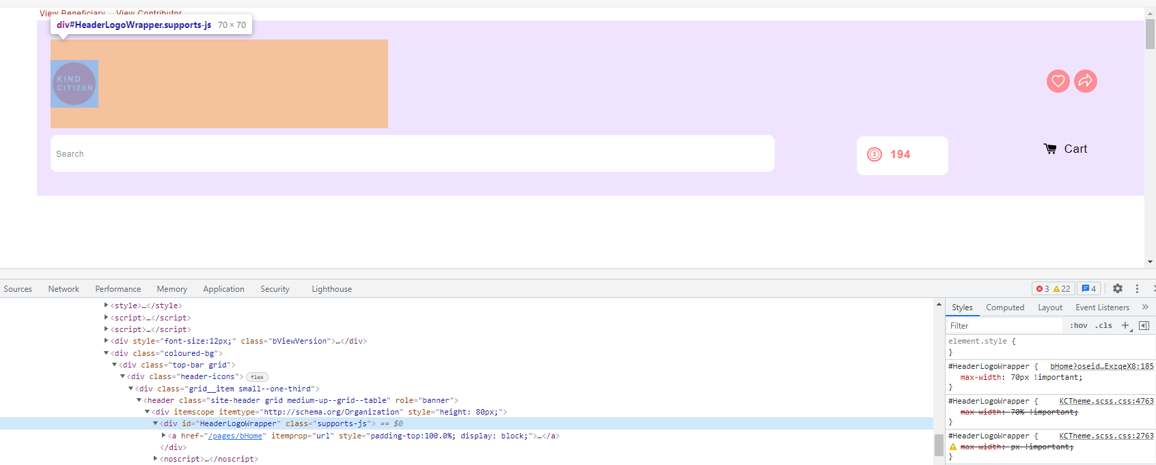
id="HeaderLogoWrapper"

